Slide 1


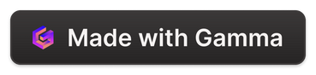
Plum Goodness: Digital Marketing Strategy
Welcome to the Plum Goodness digital marketing strategy overview. Join us as we explore the roadmap for increasing brand awareness, driving online sales, and building customer loyalty through a multi-faceted approach.
Notes:
1

Slide 2

Search Engine Optimization (SEO)
Keyword Research
On-page & Off-page Optimization
Technical SEO
We'll identify relevant keywords with high search volume, such as "vegan skincare," "cruelty-free cosmetics," and "natural beauty products." For example, the keyword "best vegan face moisturizer" has a search volume of 10,000/month.
We'll enhance user experience and search engine crawlability by improving website speed, mobile-friendliness, and site architecture. We'll strive for a Google PageSpeed Insights score of 90+ for both mobile and desktop.
We'll optimize website content, meta descriptions, and image alt text for higher search rankings. We'll also build high-quality backlinks from reputable websites and influencers. We aim to secure 50+ backlinks within the next 6 months.
Notes:
2

Slide 3
Paid Advertising (PPC)
Google Ads
Social Media Ads
Influencer Marketing
We'll run targeted ad campaigns to reach potential customers actively searching for relevant products. We'll leverage search ads, display ads, and shopping ads with a $5,000/month budget and a target ROAS of 4:1.
We'll use Facebook, Instagram, and TikTok to reach a wider audience. We'll create engaging ads with high-quality product images and videos, implement retargeting campaigns, and A/B test ad variations.
We'll collaborate with relevant influencers to promote Plum Goodness products to their followers. We'll partner with micro-influencers and macro-influencers with strong engagement rates, using unique discount codes and affiliate links to measure campaign performance.
Notes:
3

Slide 4

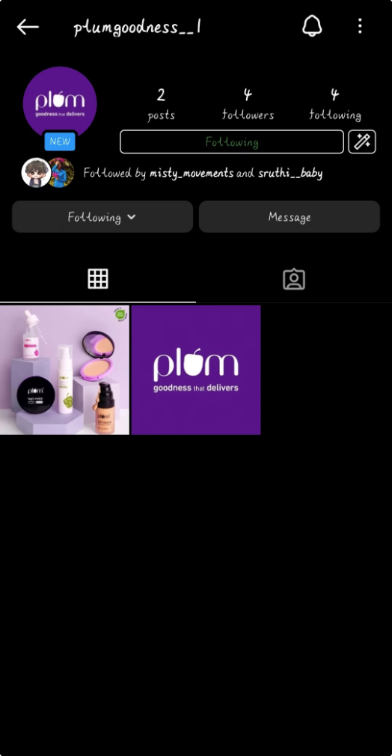
Social Media Marketing
Content Strategy
Platform Optimization
We'll create engaging content that resonates with the target audience. We'll share behind-the-scenes content, product tutorials, customer testimonials, and user-generated content.
We'll tailor content to suit the unique characteristics of each platform, focusing on high-quality images and videos on Instagram, informative posts and contests on Facebook, and short-form videos on TikTok.
Community Engagement
We'll actively interact with followers, respond to comments and messages, and foster a sense of community around the brand. We'll also host live Q&A sessions with skincare experts.
Notes:
4

Slide 5
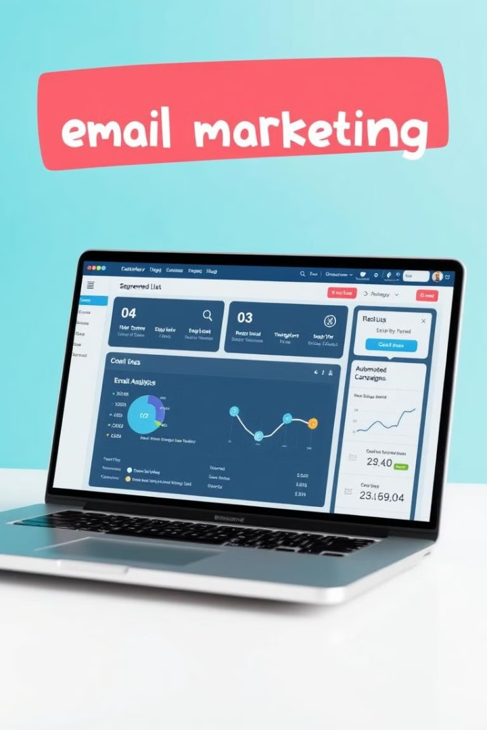
Email Marketing
List Building
Segmentation
We'll grow our email list through website opt-in forms, social media promotions, and lead magnet offers. We'll offer a 10% discount code to new subscribers.
We'll segment our email list based on demographics, purchase history, and engagement levels. For example, we'll segment subscribers based on product preferences.
Automated Campaigns
We'll set up automated email sequences to nurture leads, welcome new subscribers, and re-engage inactive customers. This includes welcome series, abandoned cart series, and personalized recommendations.
Notes:
5

Slide 6
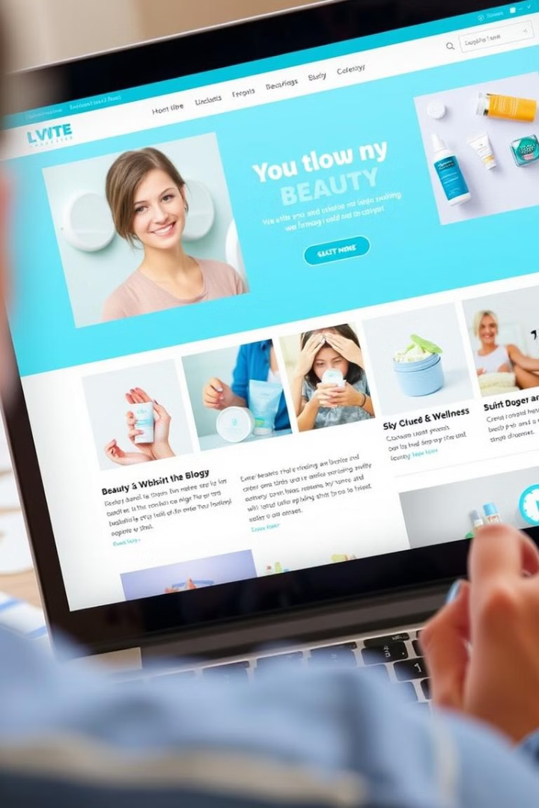
Content Marketing
1
Blog
We'll create informative blog posts targeting keywords related to skincare, beauty, and wellness. We'll optimize posts for search engines and promote them on social media.
2
Videos
We'll produce high-quality videos showcasing Plum Goodness products and their benefits. We'll create product demo videos, skincare tutorials, and behind-the-scenes content.
3
Infographics
We'll design visually appealing infographics to communicate complex information about skincare and beauty, promoting them on social media.
4
E-books
We'll develop comprehensive e-books on skincare and beauty, offering them as lead magnets to attract new subscribers.
Notes:
6

Slide 7
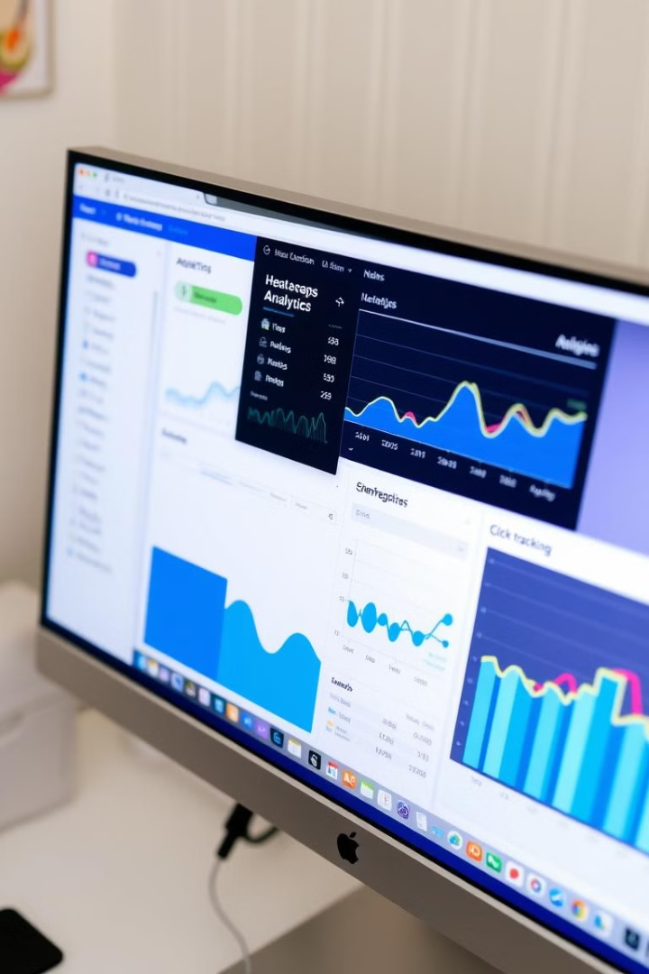




Website Optimization & Analytics
User Experience (UX)
We'll improve website navigation, design, and functionality for a seamless user experience. We'll conduct user testing and optimize website speed and mobile-friendliness.
Conversion Rate Optimization (CRO)
We'll increase the percentage of website visitors who make a purchase through A/B testing, implementing live chat, and optimizing website elements.
Google Analytics
We'll track key website metrics to understand user behavior. We'll set up goals and funnels to track the customer journey.
Heatmaps
We'll analyze user behavior on the website to understand how visitors interact with different elements. We'll identify areas that are most engaging and areas that need improvement.
Notes:
7

Slide 8
Budget Allocation & ROI Projections
$2000
$5000
$3000
SEO
PPC
Social Media
3x ROI within the first year
4x ROAS within the first year
2x ROI within the first year
$1000
$2000
Email
Content
5x ROI within the first year
2.5x ROI within the first year
We expect to generate $500,000 in additional revenue within the first year with a total investment of $156,000, yielding an overall ROI of 3.2x.
Notes:
8

Slide 9
TEAM MEBERS :
PANGA
KOMUNDURI
PRASAD
VAISHNAVI
KOLUSU
SAMMINGA
HIMAJA
VENKATA SRUTHI
Notes:
9

